Slide 1
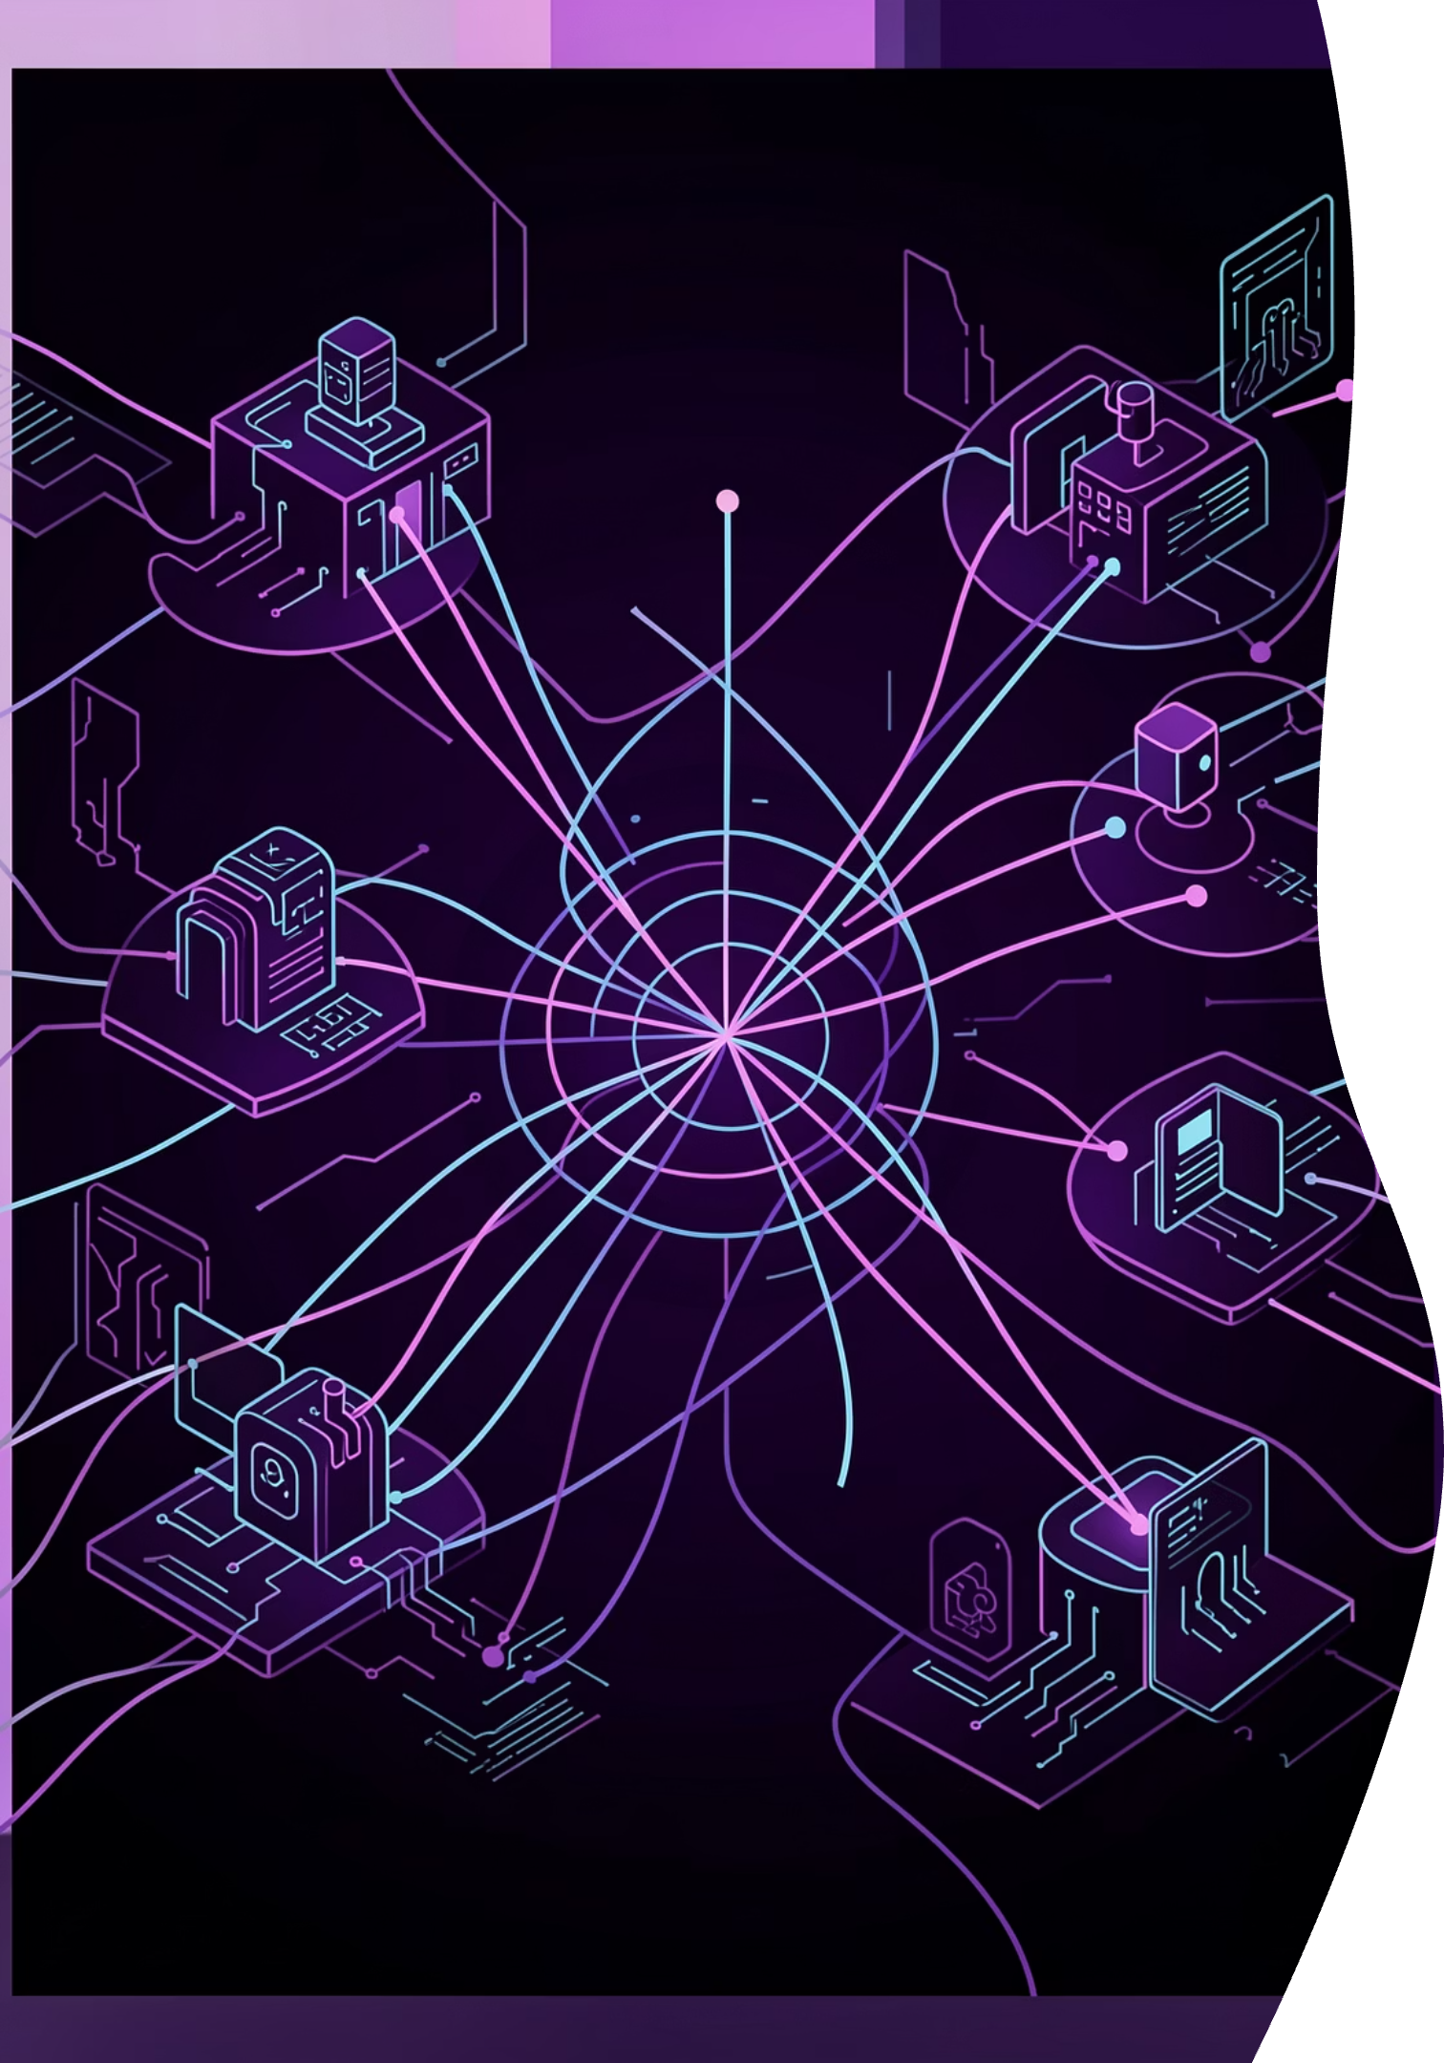
Building Multi-Agent AI Philosophers with Gemma
From Monoliths to Philosophers – A Journey into Agentic AI
Google Cloud Builder Day: Bengaluru 2026
Mayur Madnani

Slide 2




The Evolution of Intelligence
The journey of artificial intelligence reflects humanity's own intellectual development—
from rigid dogma to autonomous reasoning.
Machine Learning (The Statistical Era)
Rules-Based (The Dogmatic Era)
Systems learned patterns from data to predict outcomes. Great at classification, poor at reasoning. The neural network revolution.
Systems followed rigid, hand-crafted logic. Fragile and unable to adapt to the unknown. Think expert systems and decision trees.
Agentic AI (The Autonomous Era)
Generative AI (The Creative Era)
Systems that do. They perceive, reason, act, and learn. The shift from "Chatbot" to "Digital Coworker."
Systems that create. Context-aware and capable of zero-shot tasks, but ultimately passive—waiting for user input.

Slide 3


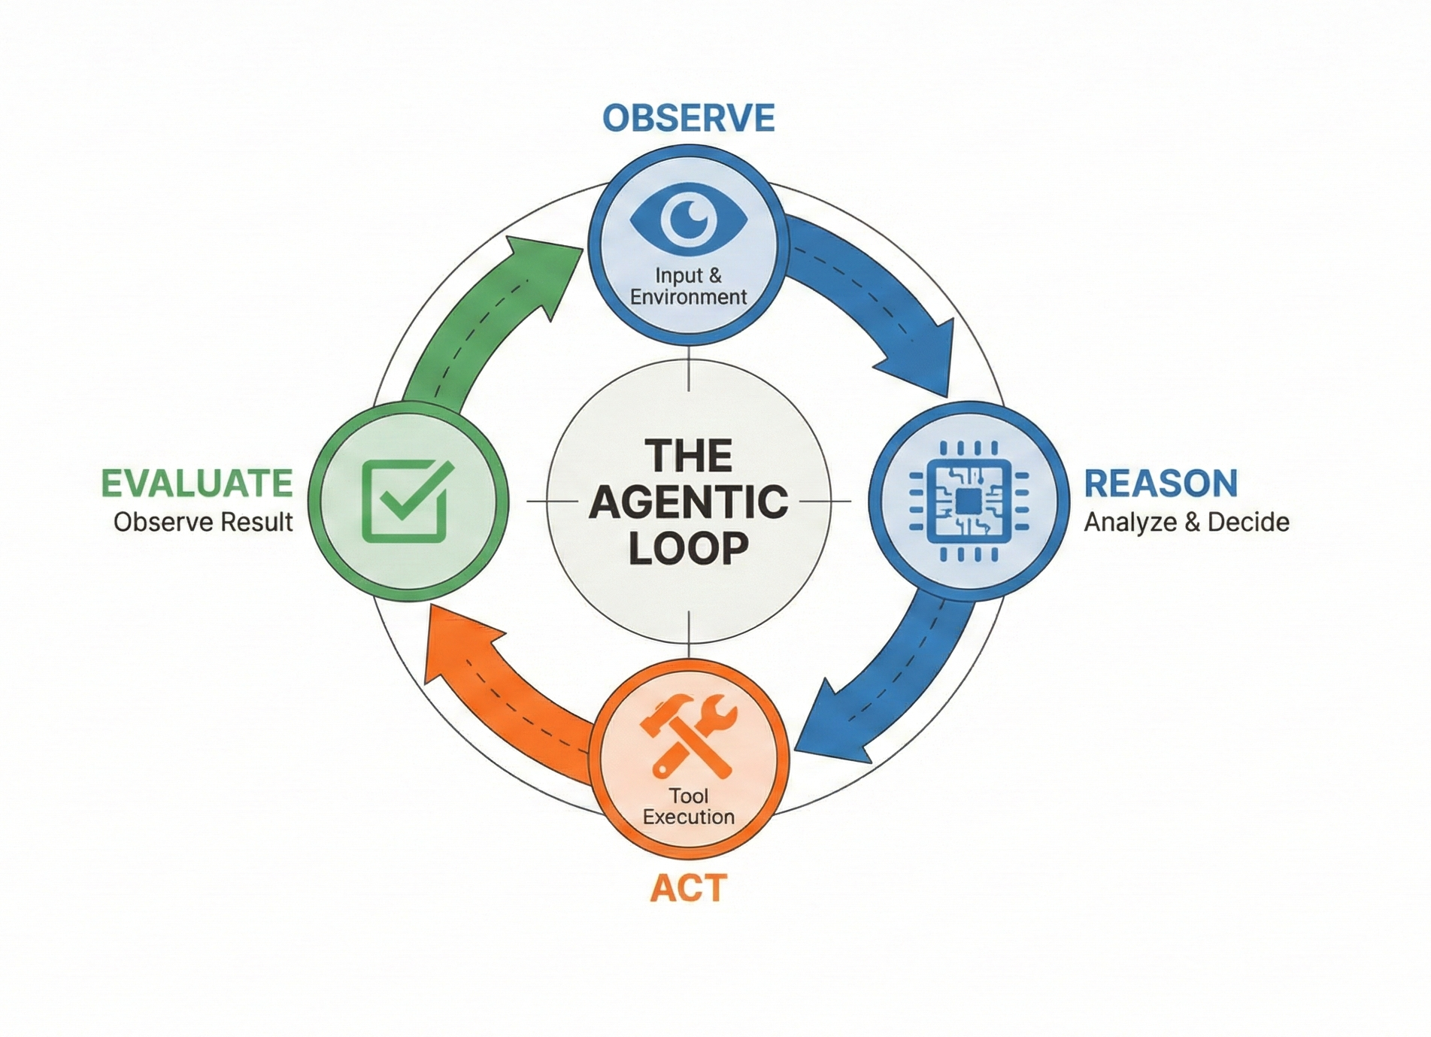


Agentic Architecture
Observe
Ingesting the environment—user goal, API state, database changes, external signals.
Reason
Analyzing observations to form a coherent plan. This is "The Brain" making sense of chaos.
Act
Executing the plan using available tools and APIs. "The Hands" making things happen.
Evaluate
Reviewing results—did it work? Learning from outcomes for the next iteration.

Slide 4
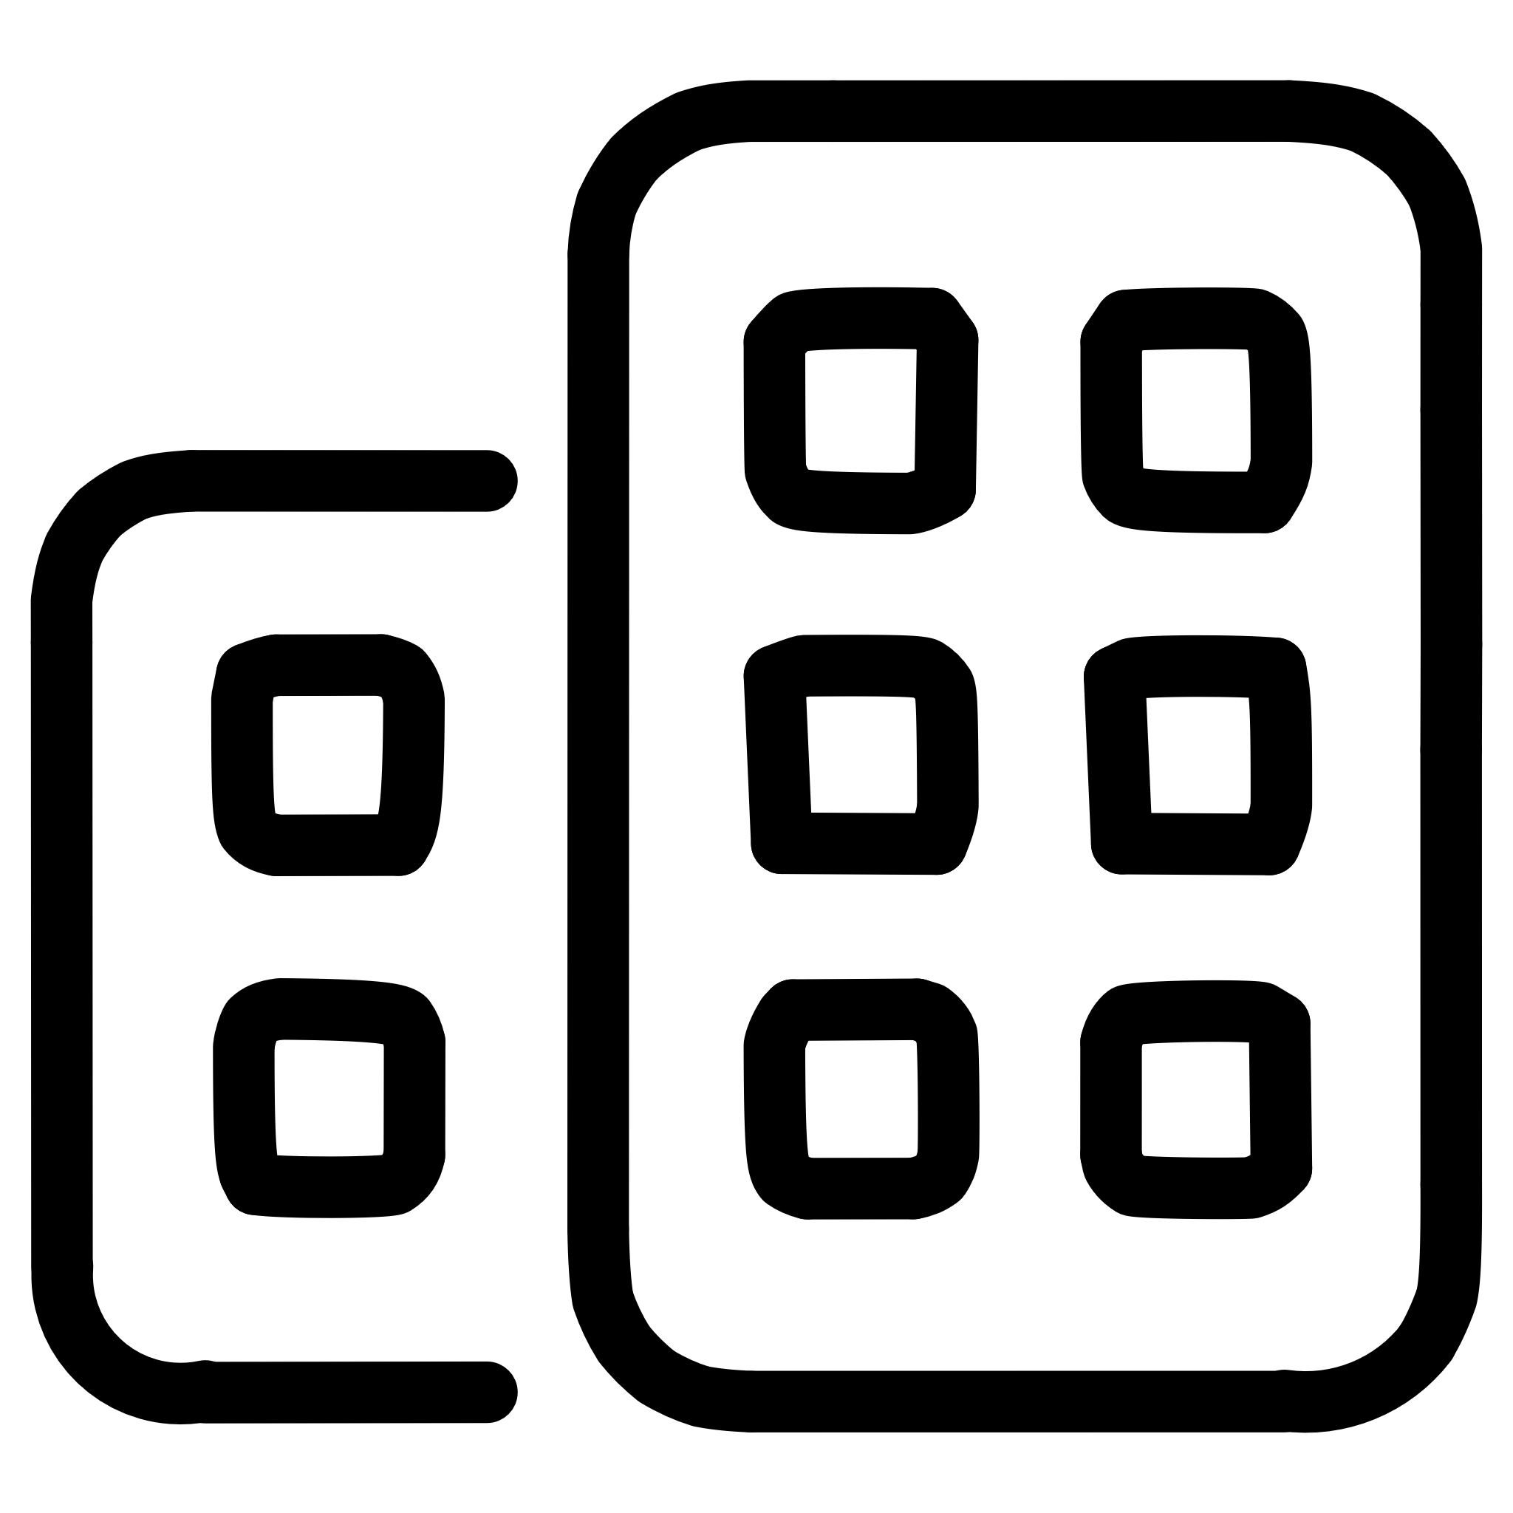

LLMs vs. SLMs – A Strategic Choice
"One Brain to Rule Them All" to "A Team of Experts”
Large Language Models
Small Language Models
Examples: Gemini, Claude, GPT-5, Grok
Role: General purpose knowledge retrieval
Agent Fit: The Orchestrator (Boss) who sees the big picture
Examples: Gemma (1B/4B/12B/27B)
Role: Domain-specific agentic workflows
Agent Fit: The Specialist (Employee) with focused expertise
We use efficient SLMs to create specialized "worker" agents that are faster and cheaper to run—enabling scalable multi-agent systems.

Slide 5
Prompting & Reliability
Engineering Thought: How We Make Agents Trustworthy
1
2
Chain of Thought (CoT)
The ReAct Pattern
"Thinking out loud." Forces the model to generate intermediate logic before the final answer.
Why it matters: Allows the agent to self-correct before taking an action—reducing hallucination risk.
This is the agent's "Short-Term Memory." It holds the persona, conversation history, and current task—all the context needed for coherent reasoning.
Reason + Act. The agent cycles through:
Thought → Action → Observation → Updated Thought. This iterative refinement is what separates agents from simple prompt-followers.
By forcing intermediate reasoning steps, ReAct enables agents to detect their own logical errors before committing to actions—critical for production systems.

Slide 6
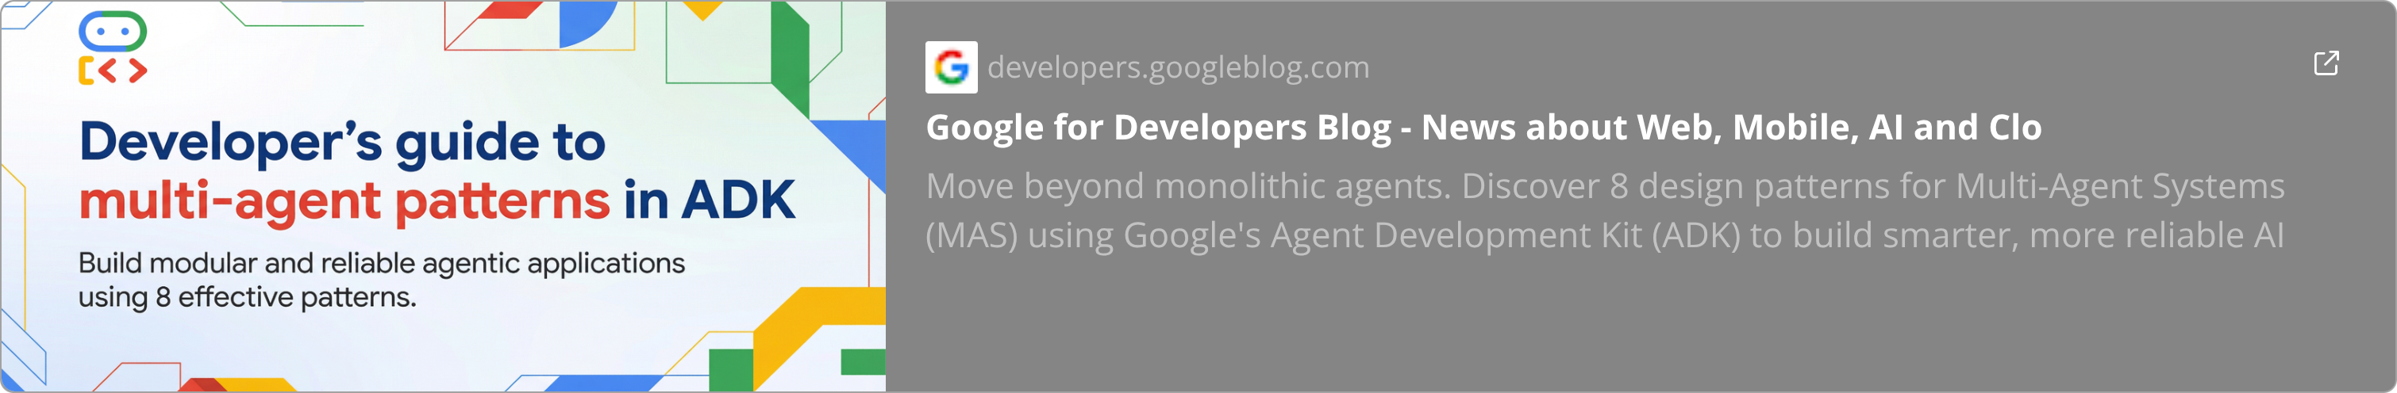



Multi-Agent Design Patterns
A single prompt cannot handle infinite complexity.
Asking one model to play Planner, Coder, and Reviewer leads to logic loops and degraded performance.
The Sequential Handoff
Agent A (Planner) creates specifications, passes them to Agent B (Coder) who implements, then to Agent C (Reviewer) who validates. Linear workflow with clear ownership.
The Orchestrator
A central "Brain" agent maintains the big picture while delegating specialized tasks to "Worker" agents. Handles dependencies and aggregates results. Hierarchical control with distributed execution.
The Parallel Fan-Out/Gather Pattern
A Coordinator agent breaks a goal into independent tasks, dispatching them to multiple Worker agents simultaneously. A Synthesizer then merges the outputs. Concurrent execution for high-speed, large-scale processing.

Slide 7
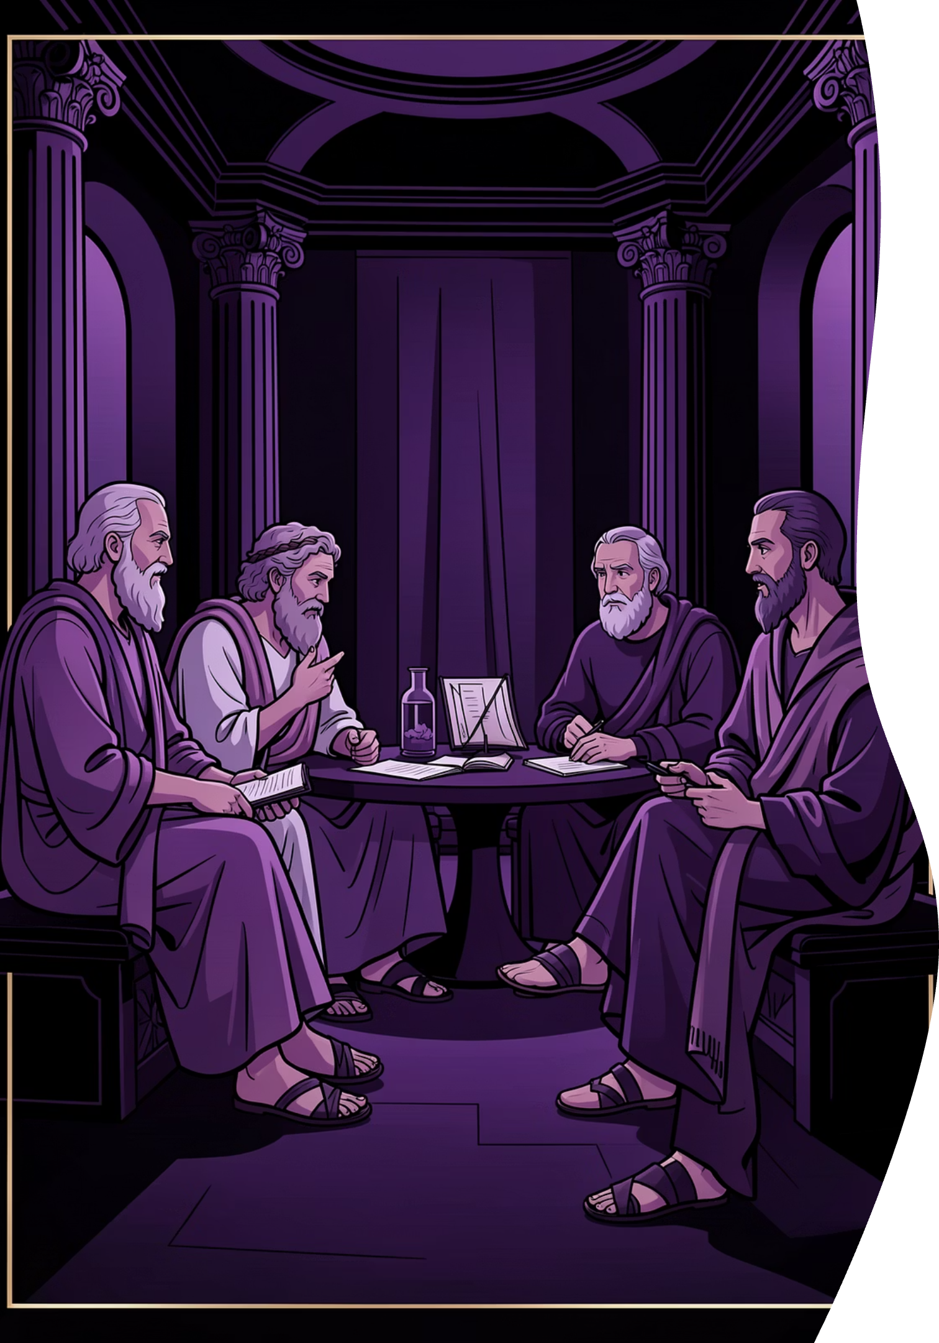
The "Philosophers" Debate Concept
A multi-agent system modeled after Plato's Republic and the Socratic Method—proving that 2,400 years of philosophical practice directly informs modern AI design.
Core Concept
Instead of generating one answer, we use argument—dialectical debate towards the best answer.
The Players
Three specialized agents powered by Gemma-SLMs, each with a distinct "System Persona" and reasoning style representing different modes of philosophical thought.

Slide 8
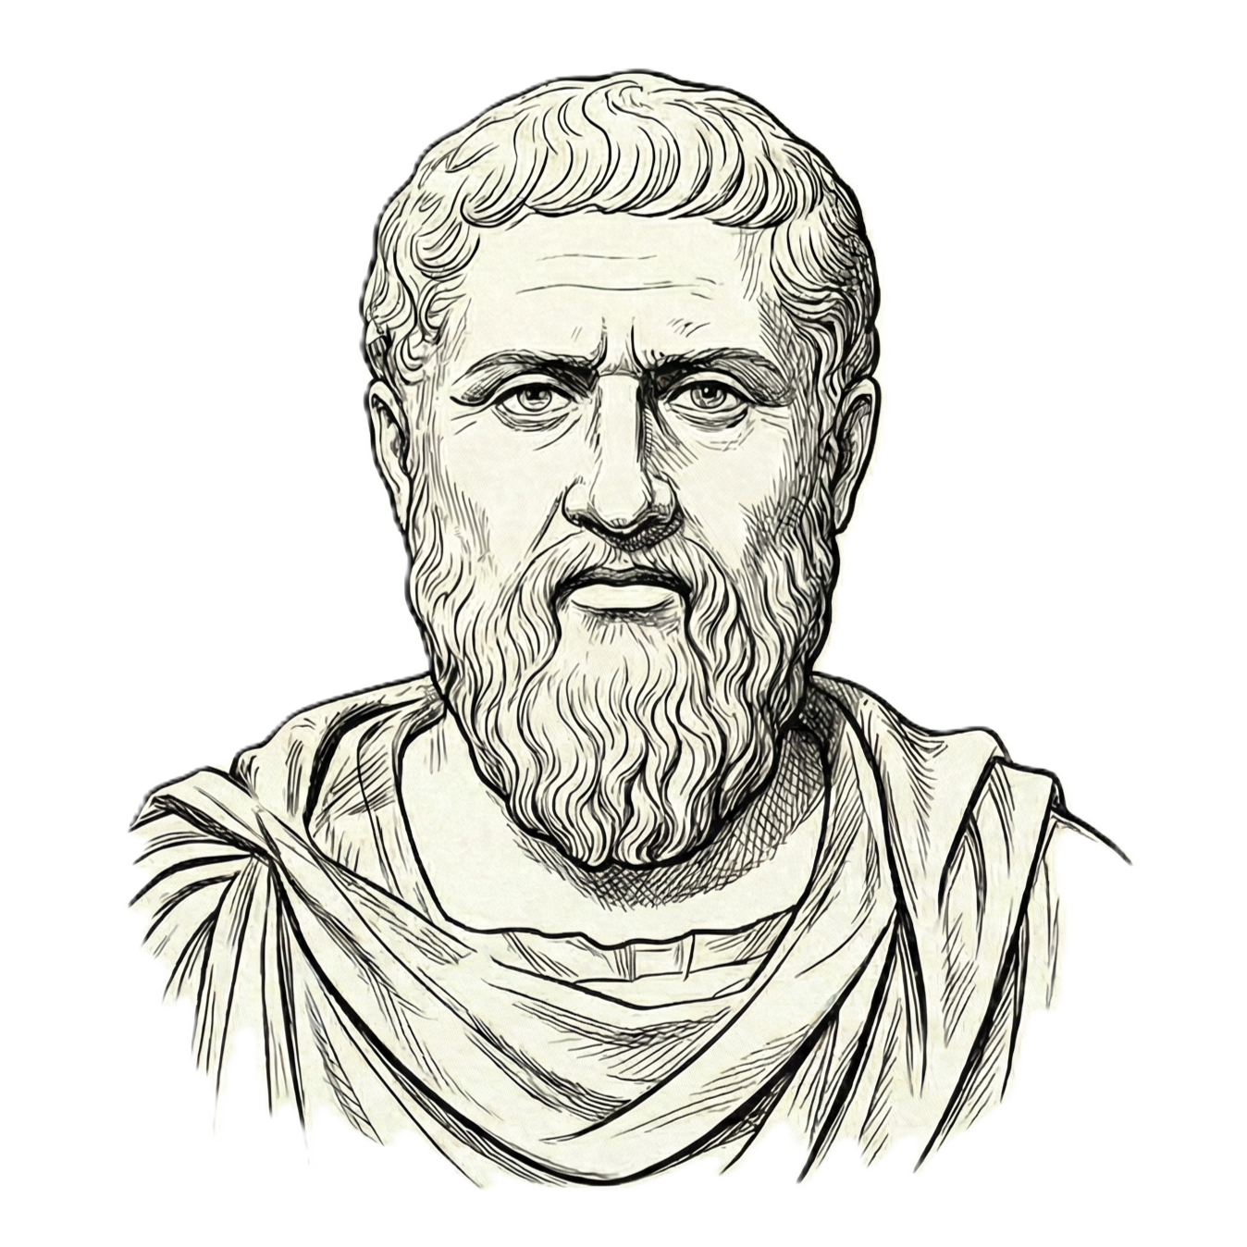
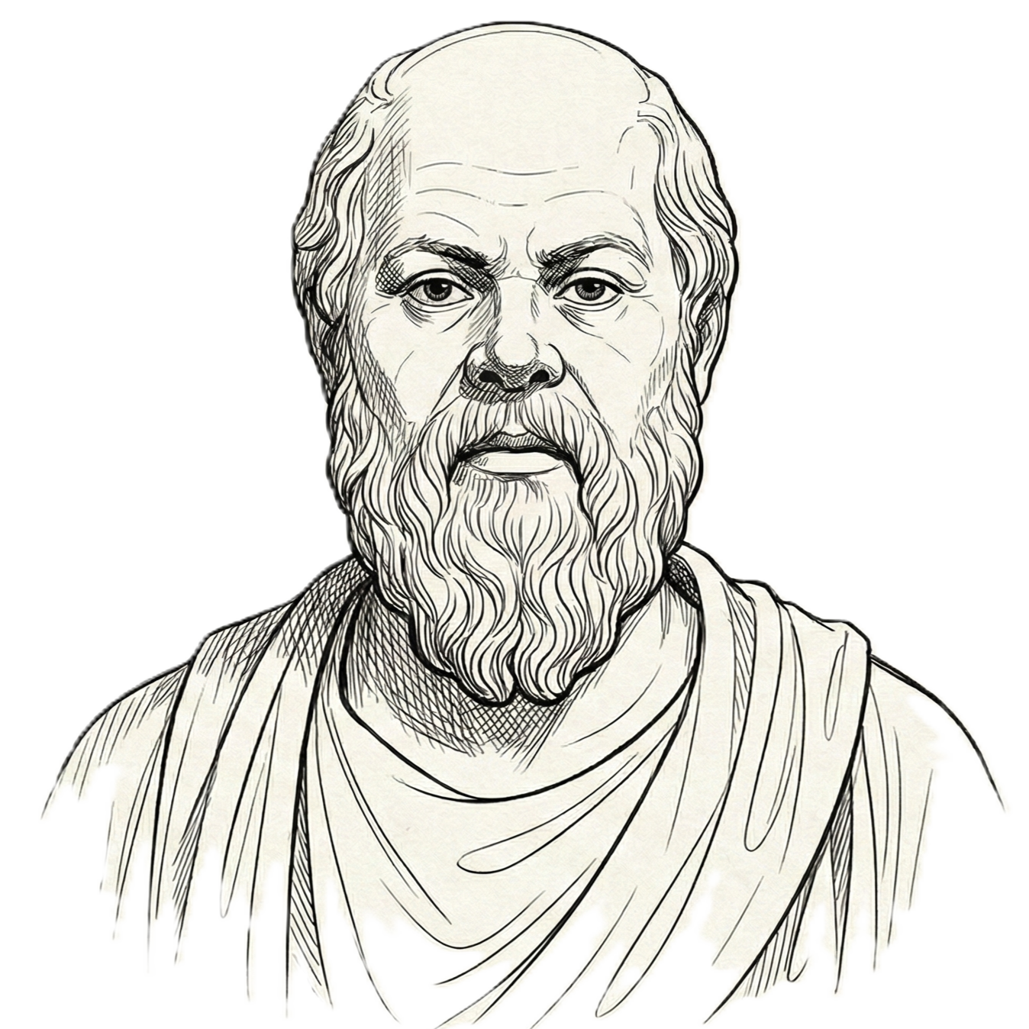
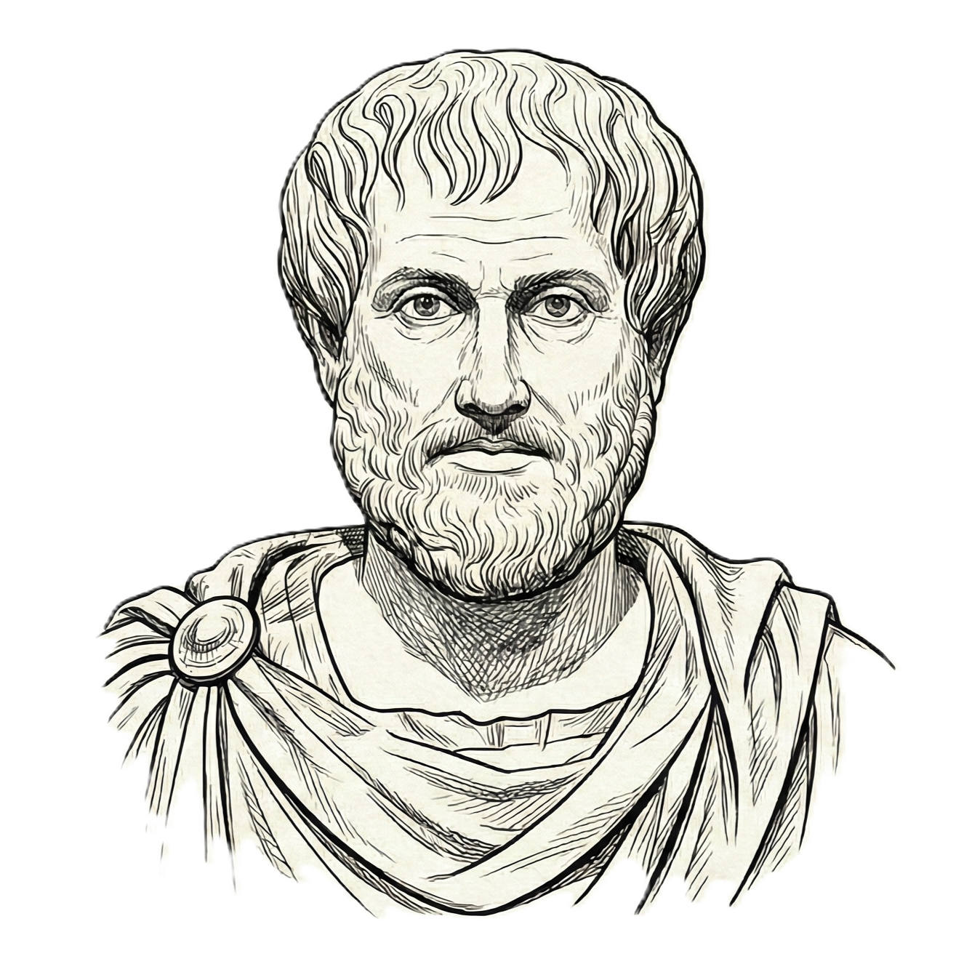
Raison d'être
"What is the ideal form of this solution?"
Mental model:
Thinks in high-level abstractions
Ignores constraints to maximize quality
Ask What's possible, not what's easy
Why we need him:
To prevent local maxima. To ensure we aim high before we compromise.
Without him, we optimize for "good enough" instead of "breakthrough."
"Is this true? What are we missing?"
Mental model:
Generates doubts
Challenges assumptions
Expose logical fallacies or edge cases
Seeks contradictions and gaps
Why we need him:
To hallucination-check the system. To force deeper reasoning by questioning everything. He's the quality gate before implementation.
"How do we build this in the real world?"
Mental model:
Grounded in logic, categories, and evidence
Obsessed with feasibility and implementation details
Translates visions into concrete specs
Asks What are our actual constraints
Why we need him:
To ensure the solution actually works. He is the bridge between abstraction and implementation.

Slide 9
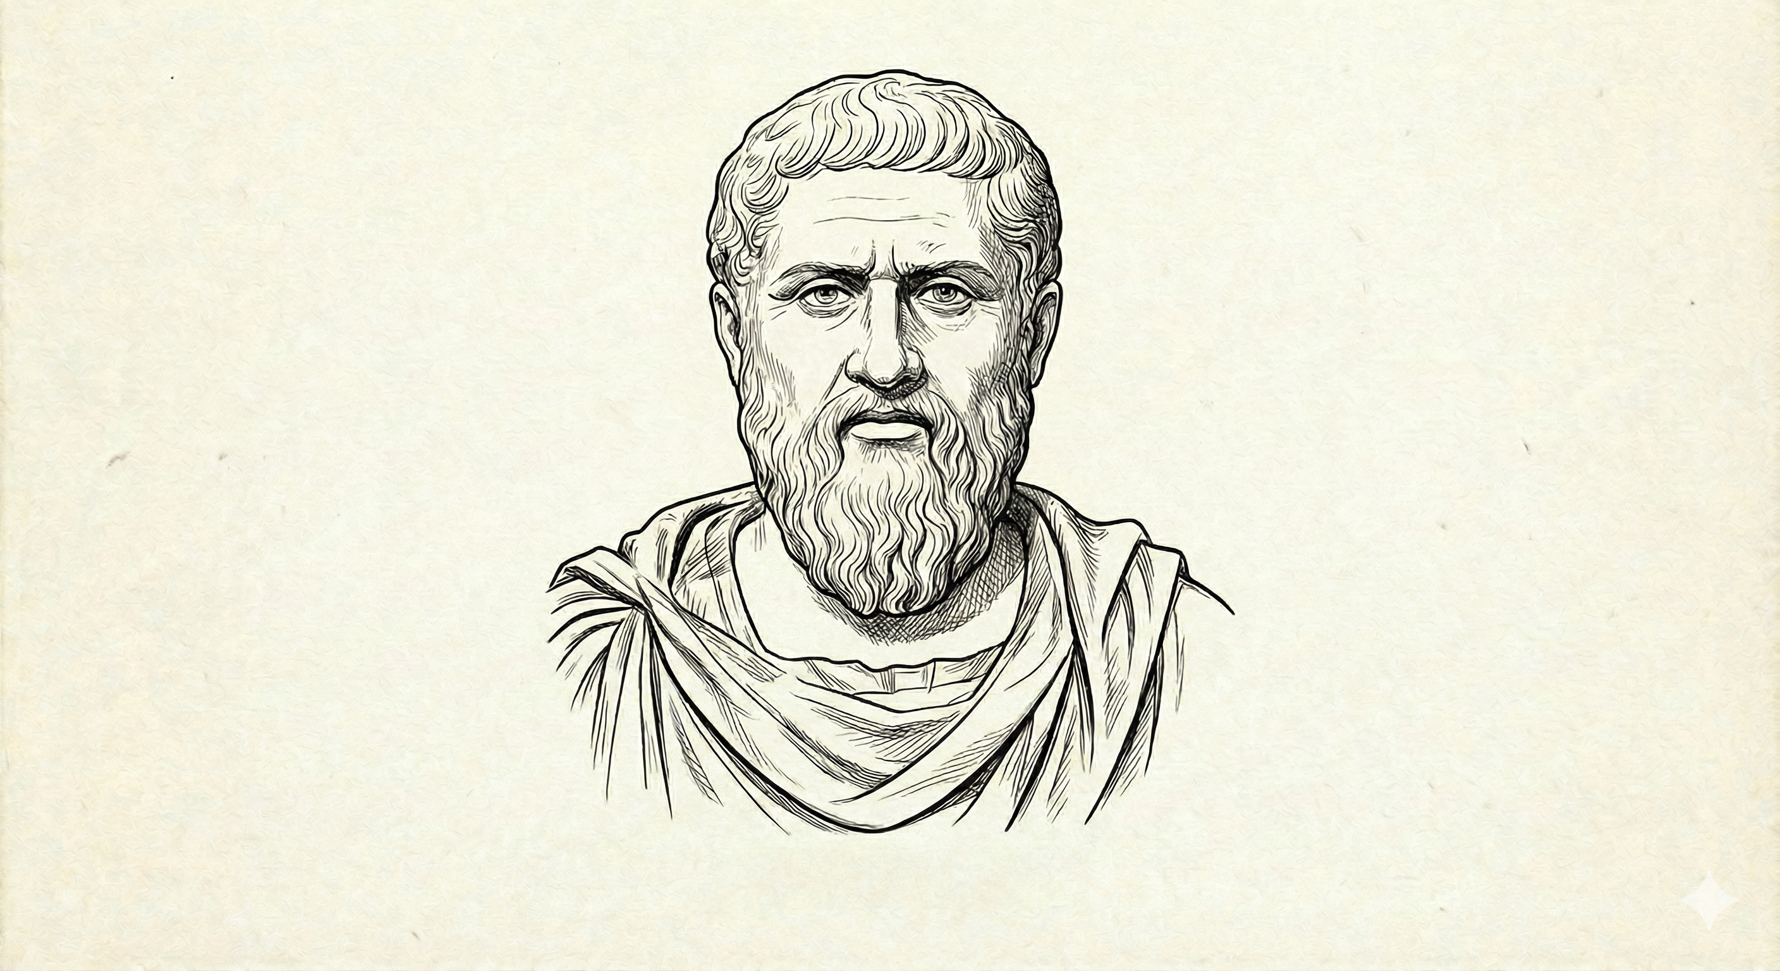
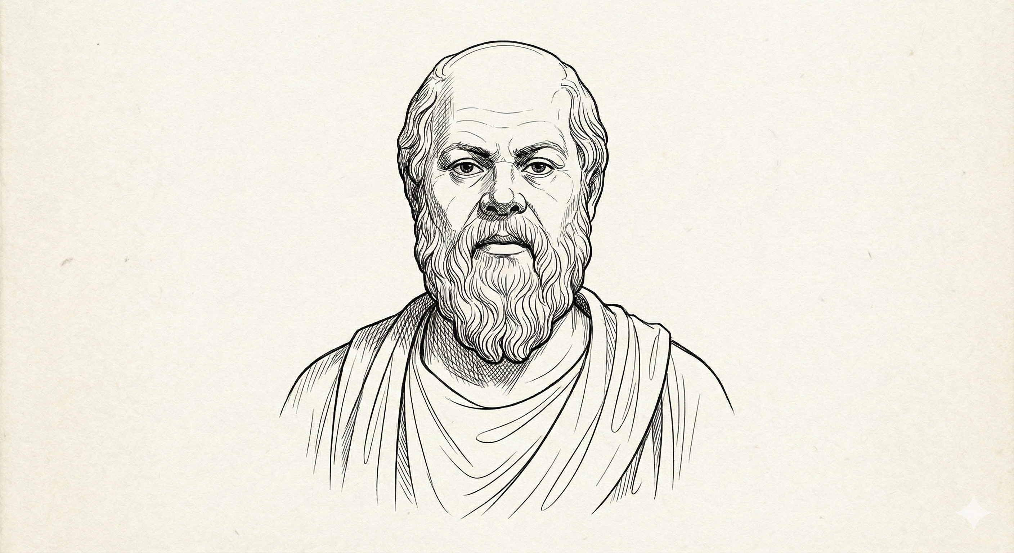
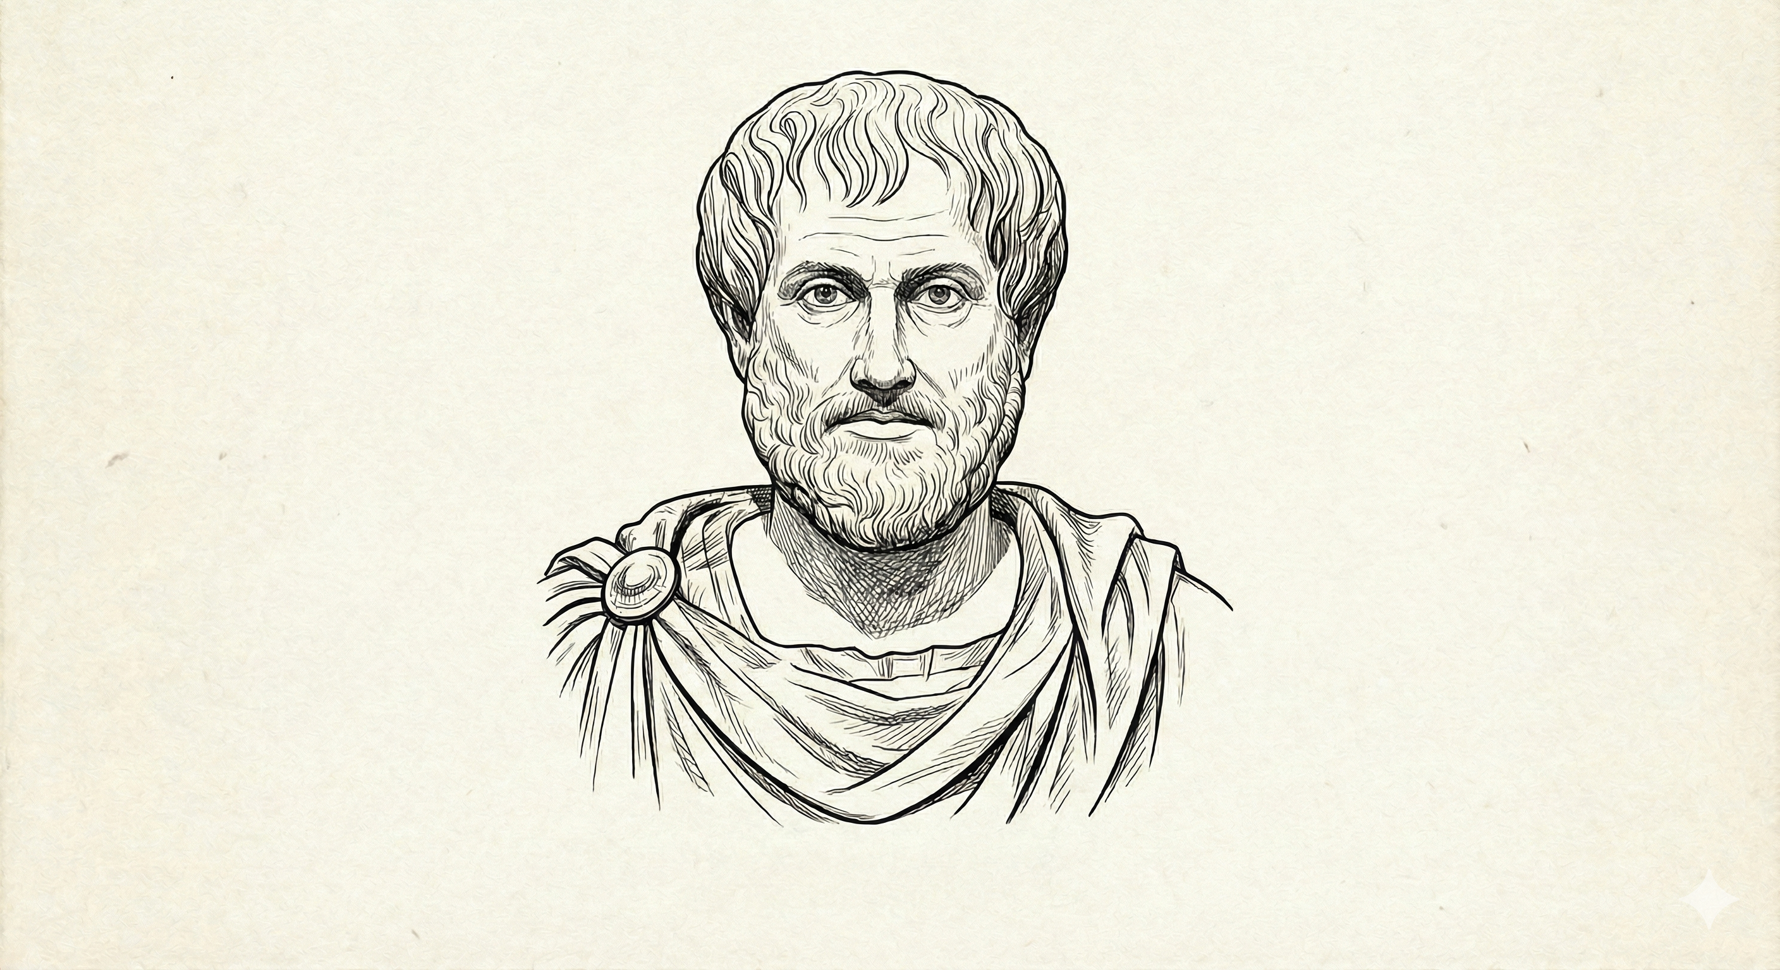
DEMO TIME
Plato
The Idealist
Seeks ideal forms, metaphysical truths, and moral dimensions.
Socrates
The Questioner
Challenges assumptions, asks probing questions, promotes critical thought.
Aristotle
The Empiricist
Analyzes systematically, focuses on logic, evidence, and categorization.
https://github.com/mayurmadnani/multi-agent-debate

Slide 10
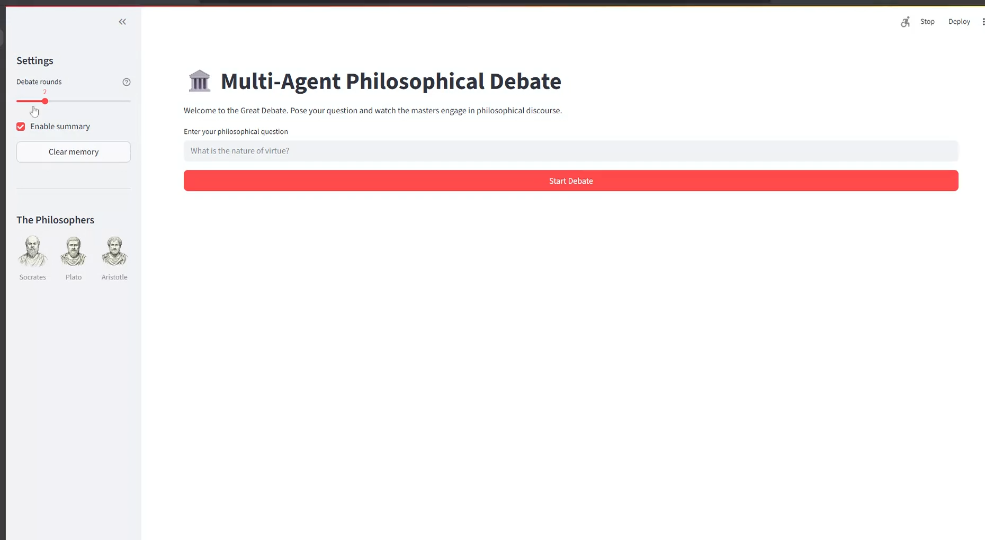

Slide 11

Thank You!!
https://linkedin.com/in/mayurmadnani

